Slide 1

DEPARTMENT OF CSE (ARTIFICIAL INTELLIGENCE AND MACHINE LEARNING) ACADEMIC YEAR 2025 - 2026 SEMESTER III ARTIFICIAL INTELLIGENCE LABORATORY MINI PROJECT REVIEW Hangman
REGISTER NUMBER | 2117240030033
NAME | Girijan D
YEAR | 2nd Year
SECTION | A
FACULTY IN-CHARGE | Mrs. M. Divya

Slide 2
PROBLEM STATEMENT
Overview of AI:
It enables systems to learn, reason, and make decisions like humans. AI uses techniques such as logic, learning algorithms, and pattern recognition to solve problems and automate intelligent behavior.
Overview of Hangman Game:
The Hangman AI Game is an interactive word-guessing game developed using Python. In this game, the computer randomly selects a word, and the player attempts to guess it letter by letter. Each guess is evaluated using logical conditions, showcasing how AI applies reasoning and decision-making to respond intelligently. This project aims to demonstrate the use of AI principles in enhancing gameplay experience, making it both engaging and educational.

Slide 3
PROBLEM STATEMENT
This project aims to develop an AI-based Hangman game that uses conditional and propositional logic to simulate intelligent reasoning and provide an interactive gameplay experience.
A fully functional interactive Hangman game that responds intelligently to player guesses.
Demonstrates decision-making and logical reasoning using conditional/propositional logic.
Provides a user-friendly graphical interface for engaging gameplay.

Slide 4
THEORETICAL BACKGROUND
Problem Statement Theory:
Simulates AI reasoning by evaluating each guess and updating the game state.
Demonstrates rule-based decision-making, a foundation of AI.
Algorithm :
Initialize the game: choose a word, set counters.
Display blanks and available letters.
Take input (guessed letter).
Check the guess:
Correct → reveal letter.
Wrong → increase wrong guess count, draw hangman.
Check game status: win or lose.
Repeat until game ends.
Optionally allow replay.

Slide 5
LITERATURE SURVEY & JUSTIFICATION
Literature Survey: Most Hangman games use rule-based conditional logic, where each player guess updates the game state through simple decision structures. This approach effectively demonstrates AI reasoning and state-based problem-solving.
Alternative Algorithms:
Frequency-Based Guessing: Predicts letters using common letter occurrence patterns.
Tree-Based Search: Narrows possible words using decision trees.
Probabilistic Models / Markov Chains: Estimates next letters based on probability.
Machine Learning / NLP: Learns linguistic patterns for adaptive and intelligent guessing.

Slide 6
ALGORITHM & EXAMPLE
Algorithm Steps:
Start the game – choose a random word.
Display blanks for each letter (e.g., _ _ _ _ _).
Take player input – guess a letter.
Check the guess:
✅ Correct → Reveal the letter
❌ Wrong → Increment wrong guess count & draw hangman
Check game status:
All letters guessed → Player wins
Max wrong guesses reached → Player loses
Repeat until game ends.
Optionally replay the game.
Example:
Word: MANGO
Player guesses: A → _ A _ _ _ ✅
Player guesses: E → Wrong → Draw hangman ❌
Player guesses: M → M A _ _ _ ✅
Continue until word is complete → Player wins

Slide 7
IMPLEMENTATION AND CODE
Link to code in Git-hub Repository
List | Git-hub Repository Links
Implementation of Code Link | https://github.com/Giri6126/Hangman/blob/main/hangman.py
Word Document Report Link | https://github.com/Giri6126/Hangman/blob/main/Hangman%20Project%20word.docx
PPT Link | https://github.com/Giri6126/Hangman/blob/main/Hangman%20Project%20PPt%20Final.pptx

Slide 8
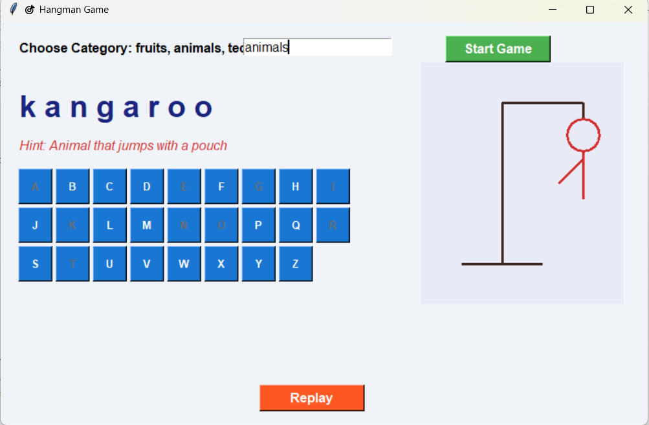
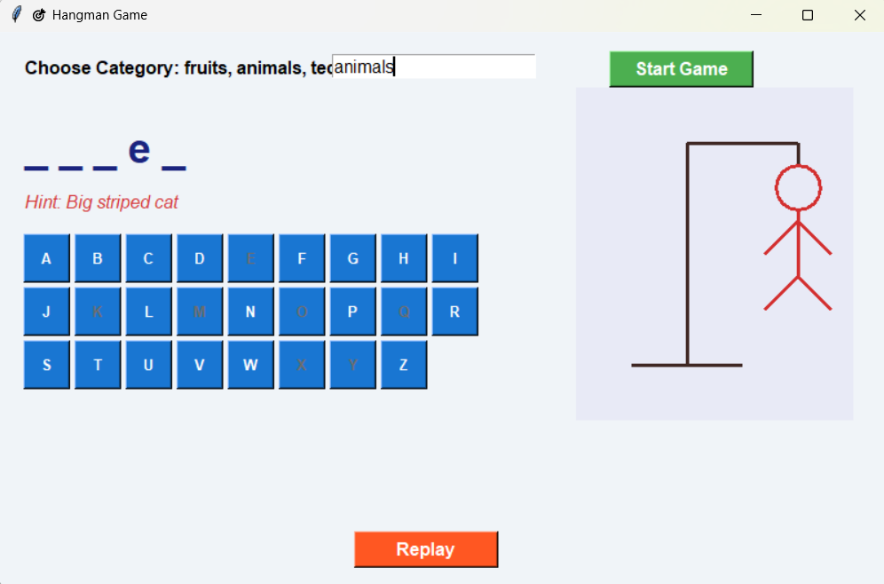
OUTPUT AND RESULTS
Results:
Fully functional interactive Hangman game with GUI.
Demonstrates AI-style decision-making using conditional logic.
Tracks player guesses and updates game state dynamically.
Future Enhancements:
Add voice or text-based word input (NLP).
Implement adaptive difficulty using AI/ML.
Introduce hint systems or predictive letter suggestions.
Extend to AI-vs-AI or multiplayer modes.
Results:
Fully functional interactive Hangman game with GUI.
Demonstrates AI-style decision-making using conditional logic.
Tracks player guesses and updates game state dynamically.
Future Enhancements:
Add voice or text-based word input (NLP).
Implement adaptive difficulty using AI/ML.
Introduce hint systems or predictive letter suggestions.
Extend to AI-vs-AI or multiplayer modes.

Slide 9
REFERENCES
Russell, S., & Norvig, P. (2021). Artificial Intelligence: A Modern Approach (4th Edition). Pearson.
Python Software Foundation. Python 3 Documentation. https://docs.python.org/3/
Python Tkinter Documentation. https://docs.python.org/3/library/tkinter.html
GeeksforGeeks. Hangman Game in Python Tutorial. https://www.geeksforgeeks.org/hangman-game-in-python/
Real Python. Python GUI Programming: Your Tkinter Tutorial. https://realpython.com/python-gui-tkinter/

